Slide 1
CN Assignment-2
Aditya Raj Jain(2022037) Vedant Gupta(2020261)

Slide 2
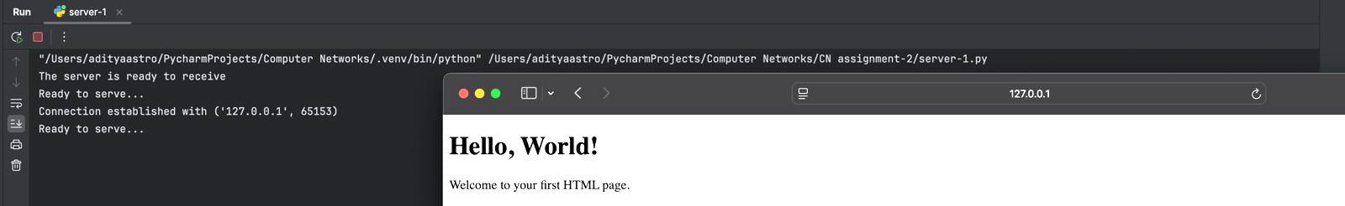
Part A
Major Objectives:
Design a web server to handle one HTTP request at a time using TCP.
Respond with a "404 Not Found" message for missing files.
Use a web browser as the client for sending requests and viewing responses.

Slide 3
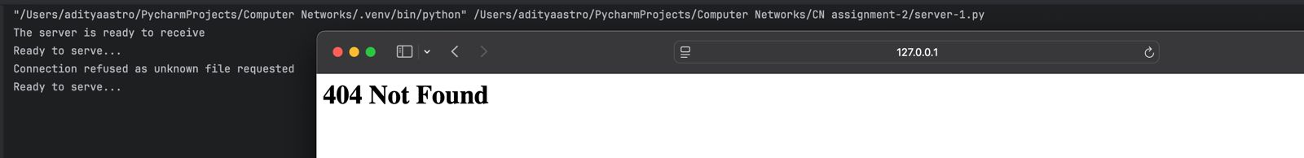
Part A
Assumptions:
The requested file is expected to exist in the server's directory.
The server listens on port 80, the default HTTP port.
A buffer size of 1024 bytes is used for decoding incoming HTTP requests.
The server handles one connection at a time with a listen queue size of 1.
The client sends a request to the server for the file HelloWorld.html.
If the requested file is not found, the server returns a 404 Not Found error.

Slide 4
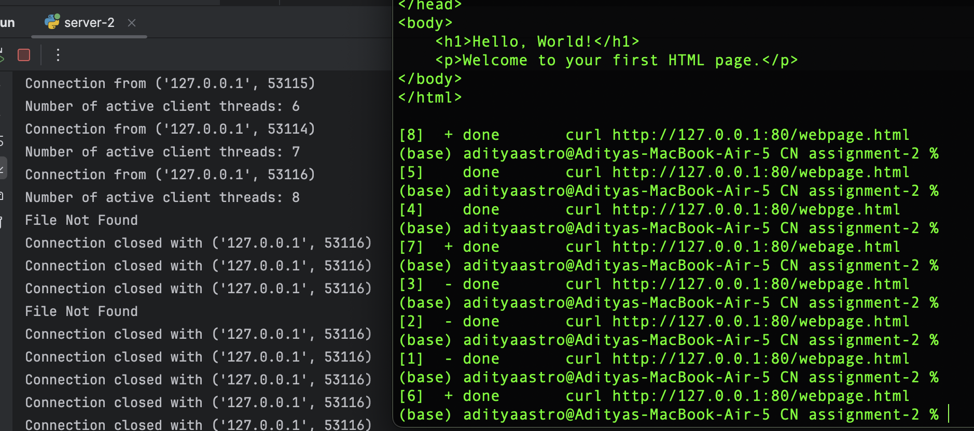
Server with Multithreading - Part B
Major Objectives:
Incorporate multithreading to allow multiple users to retrieve the HTML file simultaneously.
The server creates a new thread for each incoming simultaneous request, ensuring efficient handling of multiple connections.
Utilized the Curl command to simulate multiple requests to the server for testing its concurrent handling capabilities.
Total Requests Issued: 8
Valid Requests: 6 (Correct file names)
Invalid Requests: 2 (Incorrect file names)
The server correctly responded with "404 Not Found" for the erroneous requests.

Slide 5
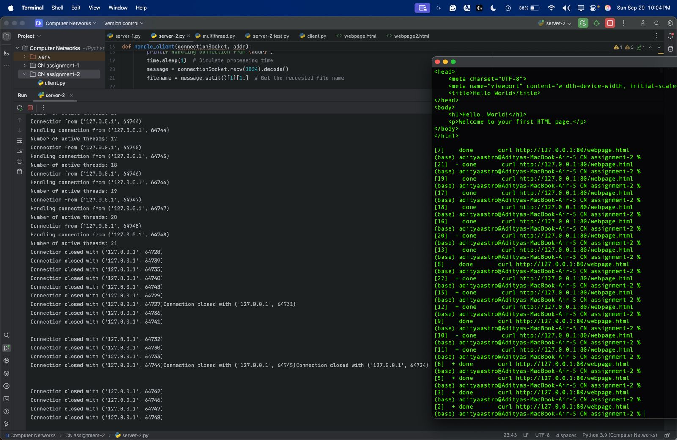
Server with Multithreading - Part B
Assumptions:
A 1-second timeout has been implemented for clear visibility of the outputs.
Utilized the curl command to test and send data to the server.
The listening queue has been increased to accommodate up to 5 connections in the queue.
Simultaneous Requests Issued: 21
Each thread successfully retrieved and served the HTML file to the corresponding request.

Slide 6
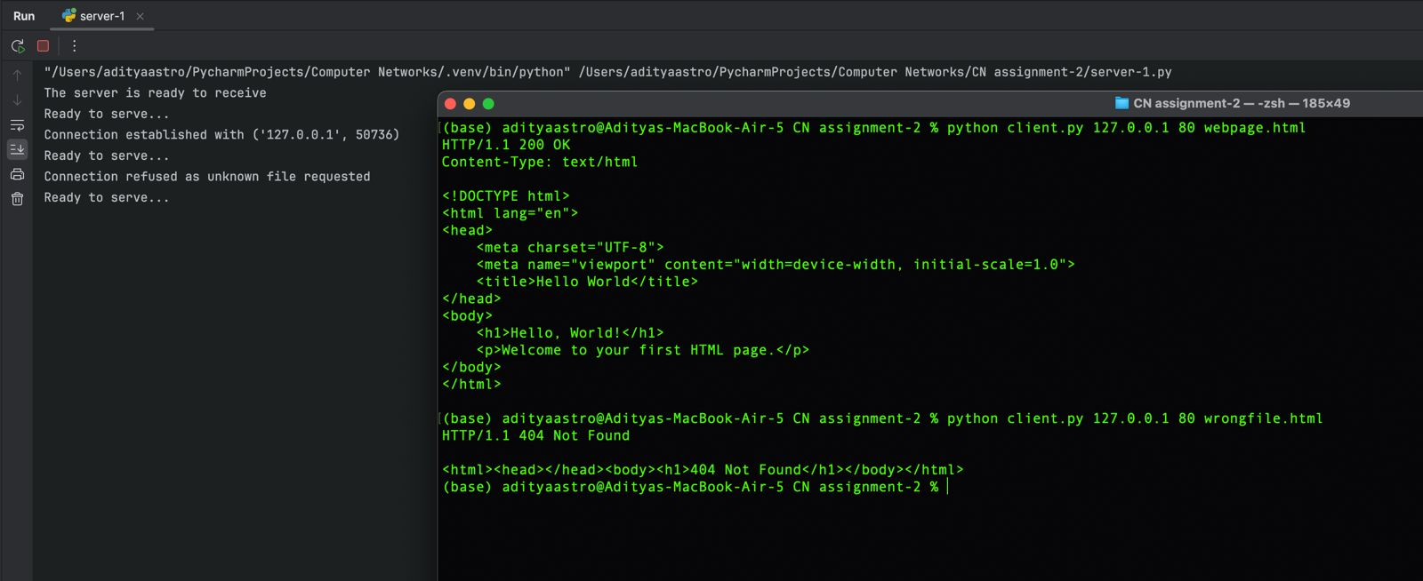
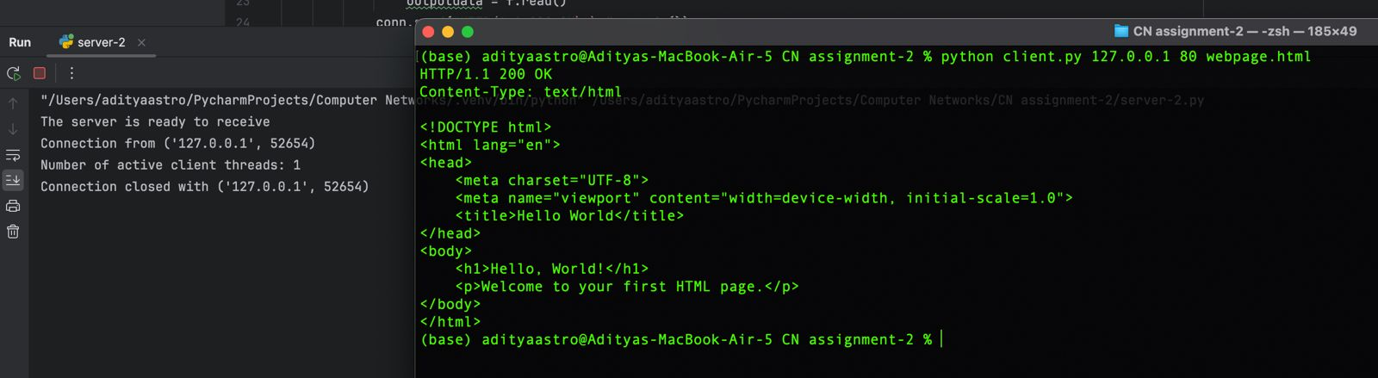
HTTP Client - Part C
Objective: Develop an HTTP client to test the server without using a browser.
The HTTP client is works on both Part 1 and Part 2 server codes i.e. the GET commands works.
The output is displayed in HTTPS format, since its displayed on terminal.

Slide 7
HTTP Client - Part C
Assumptions:
Server is operational at the specified host and port.
Client uses the GET method for requests.
Server returns requested files or 404 Not Found errors.
Responses are processed in 4096-byte chunks.
When a wrong file name is requested, a 404 Not Found error is displayed

